Slide 1



Slide 2


“
“
Transforming Your Brand
Building Relationships
-Lee Kavanagh

Slide 3

Ireland’s Multi-Award
Winning Branding
& Marketing Agency

Slide 4
Branding
Case Study

Slide 5
Table of Contents
Treacy’s Carpet and Furniture…………..
Doyle Concrete……………………………
Novum.....................................................
Magee Conservative and restoration......
Cultivate..................................................
Boss Stop................................................
Thomond Tyres.......................................
Rockmove................................................
IrelandKIND.............................................
Kilbride Coaches.....................................
Awards……………………………………...
Contact Information………………………..
06
12
18
24
30
36
42
48
54
60
66
67

Slide 6
Treacy’s Carpets & Furniture

Slide 7
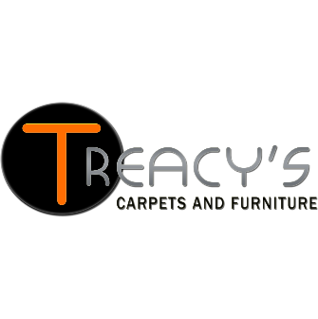
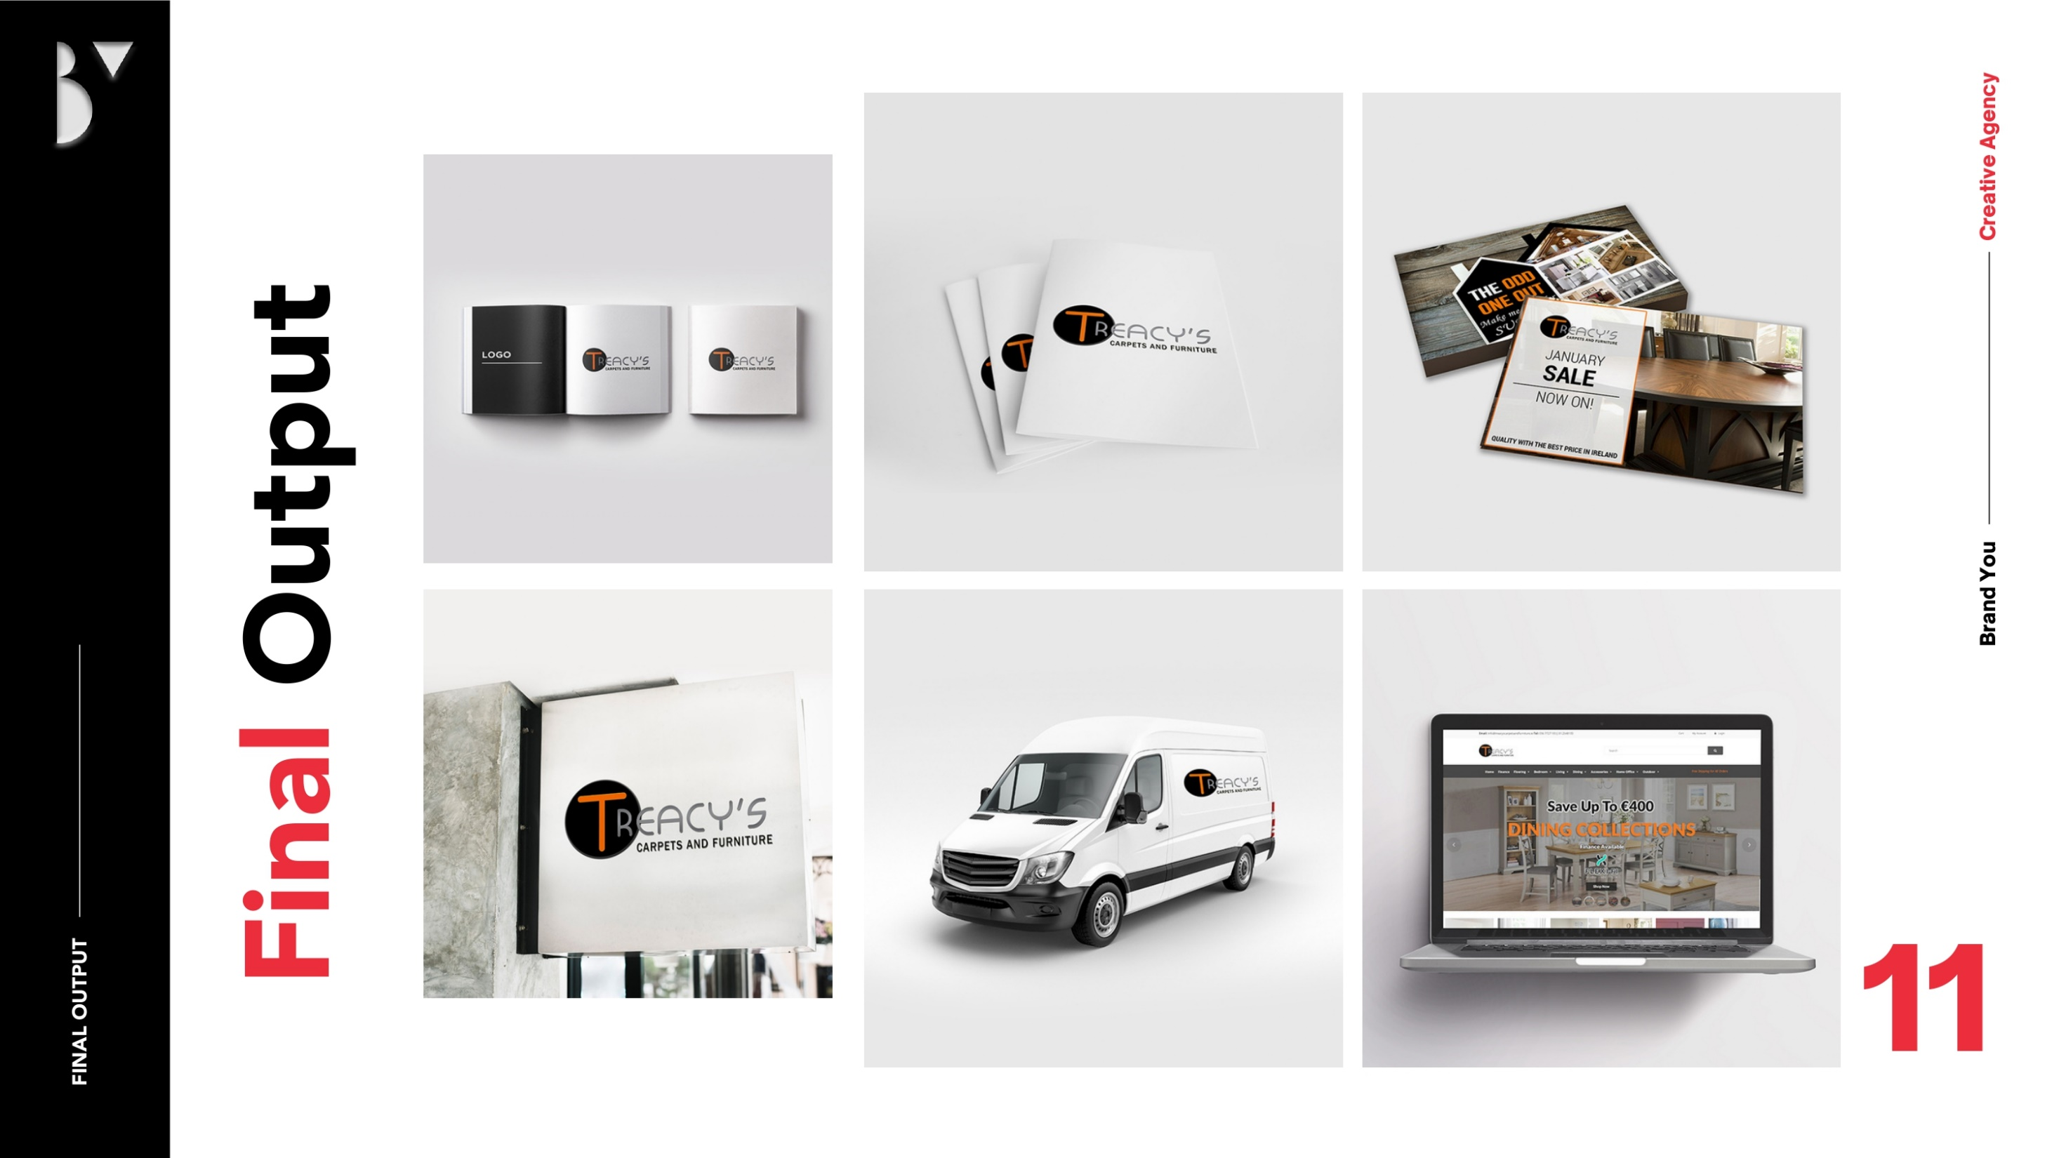
Transforming Treacy’s Carpets and Furniture for the Digital Age
About the Client
Statement of the problem………………………
Treacy’s Carpets and Furniture is a reputable, business that has been a cornerstone of the Irish furniture and flooring industry for over 56 years. Known for their high-quality products and customer-centric approach, Treacy’s had built a legacy of trust. However, as consumer behaviour evolved and the market shifted to the digital landscape, the need for modernization became apparent. For the past 14 years, BrandYou Digital Marketing Agency has been a proud partner in this transformative journey, helping Treacy’s thrive in an increasingly competitive environment.
Despite their longstanding reputation, Treacy’s faced several challenges:
The brand’; image had grown dated, failing to resonate with modern consumers.
A lack of a strong online presence limited their ability to reach a broader audience.
Ineffective targeting strategies struggled to attract the desired customer demographics.
Poor brand positioning in a crowded market hindered their growth potential.
These issues called for a comprehensive overhaul of their branding and marketing strategies to align with the demands of the modern retail landscape.

Slide 8
Our Approach & Solution
BrandYou implemented a strategic, multi-faceted approach to address Treacys’ challenges:
  Comprehensive Rebranding
Refreshed Treacys’ visual identity to ensure it appealed to contemporary consumers while respecting the brand’s heritage.
Developed a compelling brand story to deepen emotional connections with customers.
Website Design and Development
Designed a user-friendly, visually engaging website optimized for both desktop and mobile users.
Enhanced website functionality to improve user experience, drive engagement, and increase online sales.
Targeted Marketing Initiatives
Developed tailored marketing strategies incorporating social media campaigns and PPC advertising.
Crafted content that resonated with their target audience, focusing on value propositions and lifestyle integration.
Search Engine Optimization (SEO)
Conducted extensive keyword research and implemented SEO strategies to improve search rankings and organic traffic.
Regularly optimized the site’s content and structure, ensuring sustained growth in online visibility.
Social Media Growth
Built a robust presence on platforms like Facebook, achieving significant follower growth and engagement.
Utilized social media to connect directly with customers and promote brand loyalty.

Slide 9
Achievements and Results.
Our partnership with Treacy’s yielded exceptional results, transforming the brand and significantly enhancing its market presence:
Enhanced Brand Awareness and Visibility
Social media success, including a notable increase to 10,000 followers on Facebook, establishing a vibrant online community.
Strategic SEO efforts led to a 6,665% growth in organic search visibility, with sustained annual growth of 5-10% over the past decade.
Improved Search Engine Rankings
Secured 264 keywords on page one, with 164 in the top three positions and 100 between positions four and ten.
This consistent performance solidified Treacys’ reputation as a market leader in Ireland and beyond.
Record-Breaking Sales Growth
2020 and 2021 became the most successful sales years in Treacys’ 56-year history.
The business achieved a 50% growth in profitability over 14 years, driven by effective marketing and operational excellence.
Sustained Momentum
Continuous growth in subsequent years, demonstrating the enduring impact of our strategies and Treacy’s commitment to innovation.

Slide 10

Our Commitment
This remarkable journey with Treacy’s Carpets and Furniture underscores the transformative potential of a well-executed marketing strategy. At BrandYou Digital Marketing Agency, we are dedicated to empowering brands to achieve their full potential, leveraging innovative solutions and a deep understanding of market dynamics.
If your brand is ready to embark on a transformative journey, let’s work together to achieve unparalleled growth and success.
This remarkable transformation is a testament to our dedication and expertise. Partnering with us opens doors to similar transformative journeys for brands seeking to thrive in today’s dynamic market landscape.

Slide 12
Doyle Concrete

Slide 13

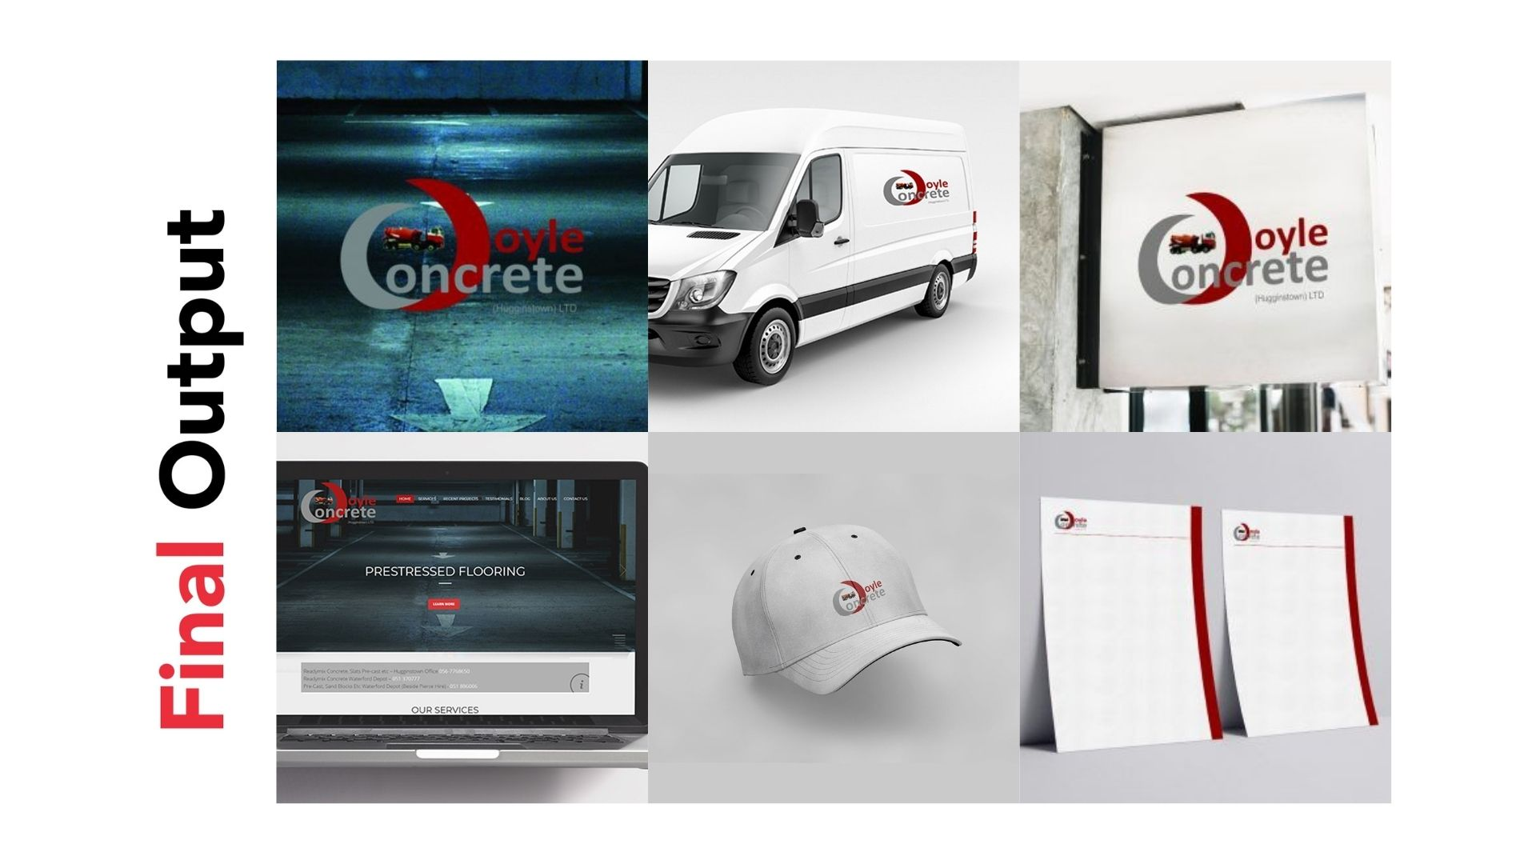
Doyle Concrete - Building a Solid Foundation for Growth
Statement of the problem………………………
About the Client
Despite Doyle Concrete’s longstanding industry presence, they were struggling to convey their brand’s full potential in a rapidly changing market. The company faced several key challenges:
Outdated Brand Identity: Doyle Concrete’s visual identity lacked the modern appeal needed to stand out in a competitive industry.
Limited Digital Presence: Their website and online communication were not optimized for user engagement or showcasing their full range of services and expertise.
Inconsistent Brand Messaging: Their brand did not consistently communicate their core strengths: expertise, reliability, and commitment to quality.
Tight Deadline: Doyle Concrete needed to undergo a complete rebranding—including a new visual identity, website, and digital strategy—within just a few weeks to stay ahead of their competition.
The stakes were high. Doyle Concrete had the potential to solidify its leadership position, but they needed a cohesive and impactful digital presence to tell their story and connect with their audience.
Doyle Concrete started as a company specializing in constructing farm buildings, playing a pivotal role in supporting the agriculture industry. Over time, they expanded their operations and established themselves as one of Ireland’s top suppliers of Ready-mix Concrete and Easy Flow Concrete Mix, essential materials for farm construction and beyond. Whether for large-scale agricultural projects or residential construction, Doyle Concrete has built a reputation for delivering top-quality products and services.
However, as the construction industry evolved, Doyle Concrete faced new challenges: the need to communicate their expertise, showcase their brand’s reliability, and effectively reach both B2B and B2C customers in an increasingly digital world. That is where BrandYou Digital Marketing Agency stepped in, transforming Doyle Concrete’s brand presence and digital footprint.

Slide 14
Our Approach & Solution
Recognizing the urgency of Doyle Concrete’s situation, we devised a comprehensive, rapid-action plan to not only meet their short-term needs but also lay the foundation for long-term success. Here’s how we approached the challenge:
Branding and Visual Identity Overhaul
We created a modern visual identity that aligned with Doyle Concrete’s reputation for quality and reliability. We incorporated colors that resonated with the construction and concrete industry—earthy tones of gray, beige, and concrete-inspired hues.
The new branding focused on simplicity and professionalism, making Doyle Concrete feel more approachable while still conveying their authority in the industry.
Bespoke Website Design
The website overhaul was central to Doyle Concrete’s transformation. We developed a UI & UX optimized, bespoke website that provided a seamless experience for both B2B and B2C customers.
The website not only showcased their range of services—ranging from concrete supply to project-based consulting and ongoing support—but also improved functionality with easy navigation and a clear call to action for prospective customers.
Comprehensive Brand and Marketing Strategy
A unified brand and marketing strategy was created to communicate Doyle Concrete’s key message: expertise, reliability, and commitment to quality.
We crafted a cohesive narrative that reflected their legacy while showcasing the company’s forward-thinking approach to modern construction solutions.
Digital Communication Strategy
Doyle Concrete’s digital presence was enhanced with a strong focus on SEO, Google AdWords, and Social Media to increase visibility and drive traffic to the new website.
We also provided video creation, story, and development to bring their brand’s story to life in a visually engaging way, increasing customer trust and engagement.
Vehicle Design & Traditional Marketing Assets
As part of the rebranding effort, we designed new vehicle graphics that transformed Doyle Concrete’s fleet into mobile advertisements, increasing brand visibility on the road.
We also provided all necessary traditional and digital design assets, ensuring consistency across all touchpoints.

Slide 15

Achievements and Results.
With a swift execution of our strategy, Doyle Concrete’s brand transformation was nothing short of remarkable. Here’s a closer look at the results:
Improved Brand Recognition
Doyle Concrete’s new visual identity and rebranded website helped the company establish a stronger presence in the market. Customers now saw the company not just as a provider of concrete, but as a trusted partner in construction.
Enhanced Website Performance
The newly designed website boosted user engagement and conversion rates, allowing Doyle Concrete to more effectively showcase their services and secure more inquiries from potential customers.
SEO and Online Visibility
With the implementation of SEO strategies, Doyle Concrete’s website saw an increase in organic search traffic, leading to better search rankings and greater visibility in search results for key industry terms.
Successful Digital Marketing Campaigns
With Google AdWords campaigns and active engagement on social media, Doyle Concrete witnessed a marked increase in online inquiries. Their presence on platforms like Facebook and LinkedIn grew, helping them connect with both B2B and B2C customers.
Increased Revenue and Market Share
The branding and marketing improvements directly contributed to a growth in both B2B and B2C sales, solidifying Doyle Concrete’s leadership position in Ireland’s competitive construction market.
Meeting Tight Deadlines
Despite the pressure of a few weeks; turnaround, our team delivered everything on time and to a high standard, proving our ability to perform under tight deadlines and exceed client expectations.

Slide 16
Our Commitment
Doyle Concrete’s journey from an outdated brand to a modern, digitally-savvy industry leader is a prime example of how the right marketing strategy can drive remarkable results. By leveraging a comprehensive rebranding, website overhaul, and tailored marketing approach, we helped Doyle Concrete not only overcome their initial challenges but also position themselves for sustained growth.
As a result, Doyle Concrete emerged as a strong competitor in the market, with a clearer identity, stronger customer engagement, and a more robust digital presence.
Just like Doyle Concrete, your business too can face challenges that seem insurmountable. But with the right strategy and expertise, you can transform your brand, build a powerful online presence, and ultimately achieve your business goals. Let BrandYou Digital Marketing Agency be your partner in this journey—together, we can build a strong foundation for your success.
This remarkable transformation is a testament to our dedication and expertise. Partnering with us opens doors to similar transformative journeys for brands seeking to thrive in today’s dynamic market landscape.

Slide 18
Novum

Slide 19
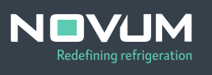
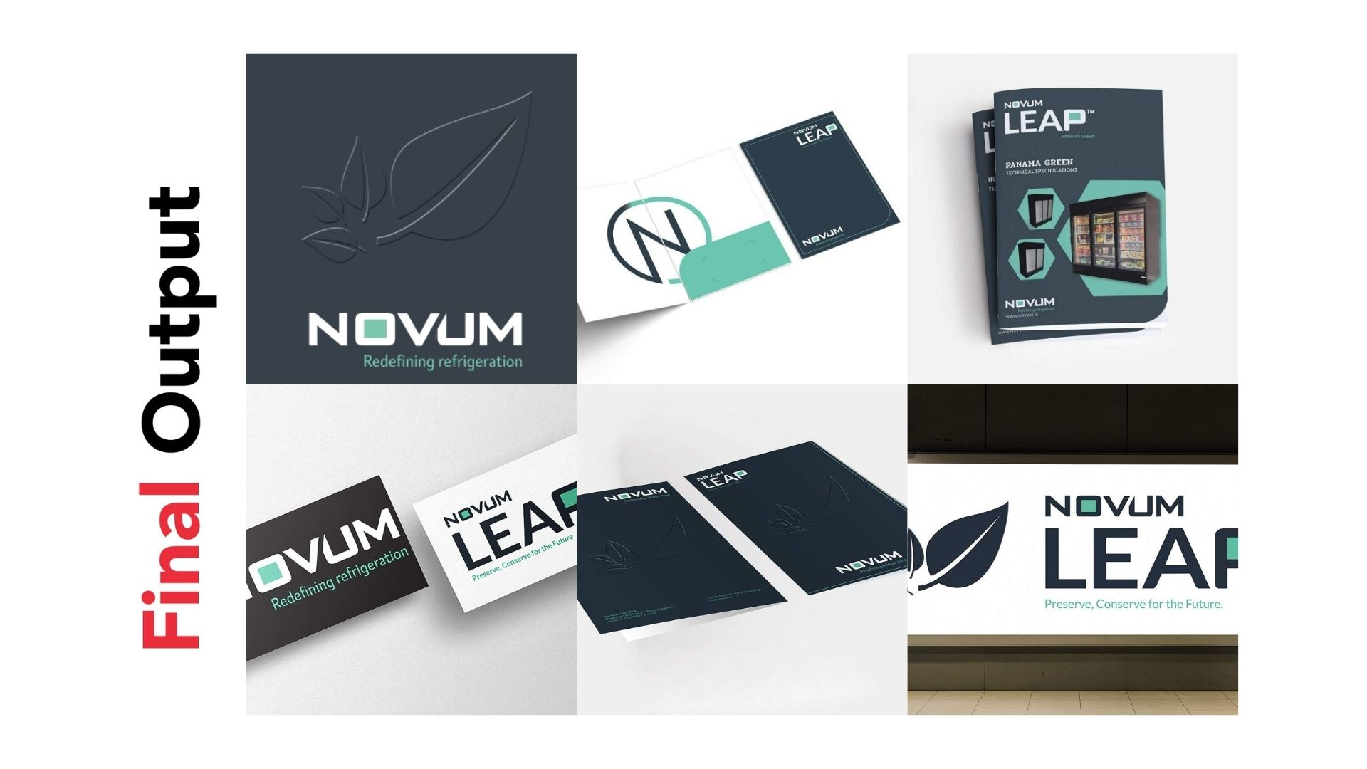
Elevating Novum to Global Recognition Through
Strategic Branding
Statement of the problem………………………
Novum’s journey as a pioneer in refrigeration was undeniable, but they faced critical challenges that threatened their ability to fully capitalize on their innovations:
Outdated Brand Perception: Novum’s existing branding did not adequately reflect their cutting-edge technology or global aspirations.
Lack of Cohesion in Product Identity: Product names lacked alignment, and trademarks were not globally registered, creating inconsistencies and potential legal vulnerabilities.
Limited Brand Awareness: The market was unaware of the full potential of Novum’s technologies and their impact on sustainability.
Suboptimal Visual Identity: The brand lacked a unified and modern visual representation across products, materials, and platforms.
Novum needed a comprehensive branding solution to bridge the gap between their technological excellence and the perception of their brand in the market.
About the Client
Novum, a trailblazer in refrigeration technology, has spent over six decades revolutionizing frozen food retail for leading global retailers. Their commitment to innovation has earned them an enviable reputation and numerous accolades for industry-transforming technologies.
At the heart of their success lies the award-winning LEAP™ Technology, a ground-breaking innovation developed at their Dublin labs. This emission-free refrigeration system is poised to reshape the retail landscape, offering future-proof solutions for a sustainable world. However, despite their technical achievements, Novum faced a challenge that required a fresh perspective and strategic intervention to align their branding with their ground-breaking technology.

Slide 20
Our Approach & Solution
Tagline Creation
Coined the tagline: "Preserve and Conserve For The Future", encapsulating Novum’s mission of innovation and sustainability.
Visual Identity and Collateral Development
Designed distinctive logos for products, ensuring alignment with the overarching brand identity.
Developed comprehensive brand guidelines to maintain consistency across all platforms and materials.
Created a visually striking company symbol, brochures, and presentation folders to enhance marketing efforts.
Vehicle Branding and Website Design
Applied the new brand identity to Novum’s fleet, transforming vehicles into mobile billboards.
Designed a user-centric website with modern UI/UX, showcasing their innovations and services through interactive features.
Delivered three design mock-ups, enabling Novum to select a layout that best represented their vision.
At BrandYou, we recognized that Novum’s story deserved to be told through a cohesive and compelling brand identity. Our approach was holistic, encompassing strategy, creativity, and meticulous execution:
Consultation and Analysis
Conducted in-depth consultations to identify internal and external branding challenges.
Recommended strategies to shift perceptions and align the brand with its innovative edge.
Naming and Trademarks
Collaborated with Novum’s team and legal experts to develop a product naming strategy.
Created the name LEAP™ for their emission-free refrigeration system, symbolizing a leap toward sustainability.
Registered the trademark globally to ensure legal protection and brand consistency.

Slide 21
Achievements and Results.
Our partnership with Novum resulted in a transformative journey that repositioned the brand as an industry leader and innovation powerhouse:
Enhanced Brand Perception
Novum’s new identity positioned them as a global leader in sustainable refrigeration technology.
The LEAP™ brand became synonymous with innovation, sustainability, and future-proofing, resonating strongly with their audience.
Unified Product Identity
Alignment across product names and visuals created a cohesive brand story.
Global trademark registration safeguarded the brand’s intellectual property.
Increased Market Awareness
The tagline and modern visual identity elevated Novum’s presence in the global market.
Brochures, presentations, and vehicle branding extended their reach, creating consistent touchpoints for customers and partners.
Digital Transformation
The redesigned website showcased Novum’s achievements and capabilities, providing a seamless experience for visitors.
The intuitive UI/UX drove higher engagement and inquiries, strengthening Novum’s online footprint.

Slide 22
Our Commitment
Novum’s transformation exemplifies how a strategic and thoughtful approach to branding can unlock a company’s true potential. By bridging the gap between their groundbreaking innovations and market perception, Novum has emerged as a global leader, not just in refrigeration technology but in sustainability and forward-thinking solutions for the retail industry.
This journey is more than a story of visual and functional rebranding; it’s a demonstration to the power of aligning a company’s identity with its core mission. The LEAP™ brand now embodies innovation, progress, and a commitment to a sustainable future, resonating deeply with customers and partners worldwide.
For businesses striving to modernize their identity, connect with their audience, and achieve measurable results, BrandYou Creativity Agency provides the expertise, creativity, and dedication to make that vision a reality. Let’s work together to shape your brand’s story and create an enduring impact in your industry.
This remarkable transformation is a testament to our dedication and expertise. Partnering with us opens doors to similar transformative journeys for brands seeking to thrive in today’s dynamic market landscape.

Slide 24
Magee Conservation & Restoration

Slide 25
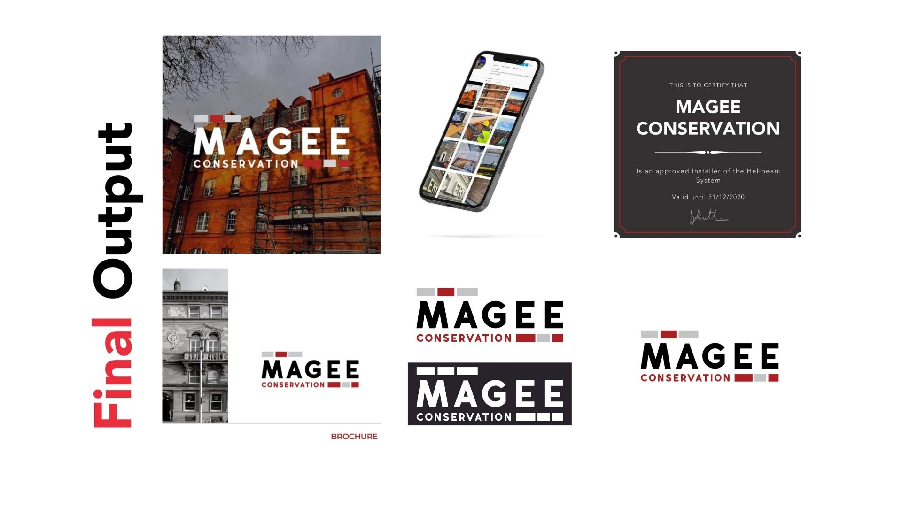
Revitalizing Magee Conservation and Restoration for Future Growth
Statement of the problem………………………
While Magee Conservation and Restoration excelled in their craft, their brand did not reflect their level of expertise or heritage focus. Key challenges included:
Lack of Cohesive Branding: Magee’s visual identity and messaging lacked consistency and did not convey their reputation or specialization effectively.
Outdated Digital Presence: The website was outdated and did not showcase their breadth of services or portfolio adequately.
Limited Brand Awareness: Magee struggled to communicate their unique value proposition to a broader audience.
Marketing Inefficiencies: The absence of a clear strategy for SEO, PPC, and social media hindered their ability to generate leads and expand their client base.
Magee needed a cohesive brand strategy to reflect their expertise, amplify their reputation, and position them as leaders in the restoration industry.
About the Client
Magee Conservation and Restoration is a premier specialist in restoring and conserving Dublin’s most iconic and historically significant buildings. Their expertise spans a range of services, including façade cleaning, stone masonry, brick conservation, traditional lime rendering, and stucco plasterwork. Trusted as Approved Surveyors and Installers of Helifix Structural Repair systems, Magee has played a pivotal role in preserving Dublin’s architectural heritage.
Despite their technical prowess and prestigious clientele, Magee faced challenges in aligning their brand image with their exceptional work. This is where BrandYou stepped in to craft a story as timeless as the structures Magee preserves.

Slide 26
Our Approach & Solution
At BrandYou, we partnered closely with Magee to develop a comprehensive branding and marketing strategy that honoured their legacy while paving the way for future growth.
Discovery and Consultancy
Conducted an in-depth brand audit and analysis to understand Magee’s strengths, weaknesses, and opportunities.
Aligned their brand culture and identity with their business goals and target audience.
Brand Strategy and Identity Development
Crafted a robust brand strategy that emphasized Magee’s role in preserving Dublin’s architectural heritage.
Designed a refreshed visual identity, including a timeless logo that resonated with their craftsmanship.
Developed brand guidelines, ensuring consistency across all materials.
Content and Collateral Creation
Created professional brochures, business cards, and letterheads to elevate Magee’s communications.
Designed a user-friendly website plan, including modern UI/UX, and sourced and optimized high-quality images to showcase their work.
Digital Marketing Strategy
Audited existing PPC, SEO, and social media efforts, identifying areas for improvement.
Delivered a 3-month plan focused on boosting Magee’s online visibility through targeted SEO, strategic PPC campaigns, and engaging social media content.

Slide 27
Achievements and Results.
Our collaboration with Magee resulted in transformative changes that enhanced their brand perception and business outcomes:
Elevated Brand Identity
The new logo and visual identity positioned Magee as a premium, authoritative figure in the conservation industry.
Unified branding across brochures, business cards, and digital platforms built trust and recognition among clients.
Improved Digital Presence
A redesigned website with a modern, intuitive interface effectively showcased Magee’s services and expertise, leading to increased inquiries and engagement.
Optimized images and professional content elevated the website’s overall aesthetic and usability.
Boosted Market Awareness
The SEO and PPC strategies drove significant increases in web traffic and lead generation.
Enhanced social media presence allowed Magee to connect with a broader audience, sharing their story and projects effectively.
Clear Strategic Direction
The brand guidelines manual provided a roadmap for maintaining consistent and impactful branding in all future initiatives.
The 3-month digital marketing plan established a foundation for long-term growth and competitive positioning.

Slide 28
Our Commitment
Magee Conservation and Restoration’s story is one of transformation. From a trusted craftsman of the past to a modern, authoritative brand, Magee has emerged stronger, more recognizable, and positioned for sustained growth.
Through our partnership, Magee now stands as a shining example of how a cohesive brand strategy can bridge tradition with modernity, amplifying both legacy and potential. Their success story highlights the power of aligning branding, digital presence, and marketing strategies to achieve impactful results.
At BrandYou, we take pride in helping businesses like Magee preserve their legacy while preparing for the future. Let us help you build your own success story—because your brand deserves to shine just as brightly.

Slide 30
Cultivate

Slide 31
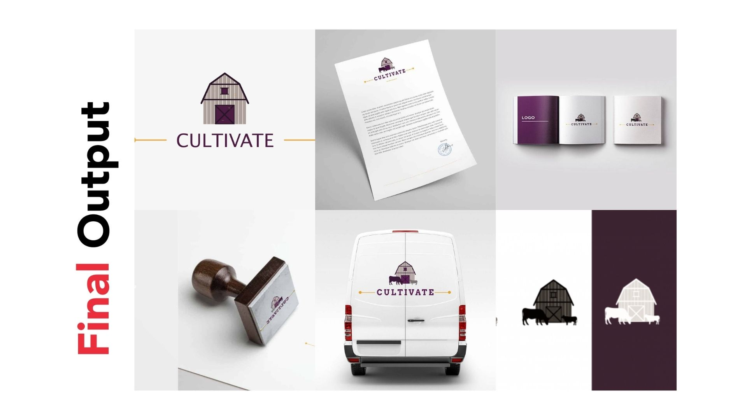
Empowering Cultivate to Lead in Food Sustainability Across Europe
About the Client
Cultivate is a government-sponsored initiative dedicated to advancing food sustainability from farm to table. Operating across Ireland, America, and Europe, Cultivate focuses on serving European countries like Poland and the Czech Republic, with plans for expansion into additional markets. Their mission is to be a trusted leader in innovative solutions that promote sustainability across the agricultural food industry.
Despite their noble goals, Cultivate faced challenges in effectively positioning themselves as the go-to authority in food sustainability, particularly in the European market. To address these hurdles, they partnered with BrandYou Creative Marketing Agency, seeking expertise in branding and digital marketing.
Statement of the problem………………………
Cultivates aspirations to lead the European food sustainability movement were hindered by several key challenges:
Lack of a Cohesive Brand Identity:
Cultivate lacked a clear, resonant identity that could communicate their values and mission across diverse markets.
Urgency of Execution:
With only a few weeks to develop a brand name and identity system for their European program, the timeline was tight.
Geographically Dispersed Teams:
The need for remote collaboration across different time zones added complexity to the branding process.
Competitor Landscape:
Cultivate needed a distinctive identity to stand out in a crowded field, with competitors like McDonald’s sustainability initiatives setting a high bar.

Slide 32
Our Approach & Solution
At BrandYou, we embraced the challenge with determination and a clear strategy to deliver impactful results within the tight deadline:
Rapid Immersion and Collaboration
Dedicated an intensive weekend to fully understand Cultivate’s mission, values, and market aspirations.
Conducted online meetings to collaborate with key stakeholders, ensuring clarity and alignment without the need for in-person interactions.
Brand Naming and Identity Development
Created a range of strategic brand names that captured Cultivate’s commitment to sustainability, innovation, and collaboration.
Presented storyboards to senior managers, illustrating how the names would resonate across cultures and languages in the European market.
Visual Identity System
Designed a cohesive brand identity system featuring a modern logo, color palette, typography, and iconography that reflected Cultivate’s sustainable ethos.
Developed a comprehensive brand style guide and guidelines manual to ensure consistency across all touchpoints.
Digital and Social Media Designs
Created compelling web and social media designs that highlighted Cultivate’s initiatives and values.
Delivered designs optimized for digital platforms, reinforcing Cultivate’s credibility and appeal to diverse audiences.

Slide 33
Achievements and Results.
The partnership between BrandYou and Cultivate resulted in a swift and effective transformation that positioned the brand as a leader in the European food sustainability sector:
Compelling Brand Identity
The new name and visual identity encapsulated Cultivate’s mission and values, resonating with stakeholders and consumers alike.
The cohesive brand system differentiated Cultivate from competitors, establishing it as a forward-thinking, trustworthy brand.
Seamless Remote Execution
Despite geographical and logistical challenges, the project was completed on time and exceeded client expectations, showcasing the effectiveness of our online collaboration process.
Enhanced Digital Presence
The digital and social media designs reinforced Cultivate’s brand story, driving engagement and awareness among European audiences.
These assets laid the foundation for future marketing campaigns to support their expansion plans.
Foundation for Growth
The brand guidelines ensured consistency as Cultivate expanded its reach, providing a framework for successful implementation across all channels and markets.
Our commitment
This remarkable transformation is a testament to our dedication and expertise. Partnering with us opens doors to similar transformative journeys for brands seeking to thrive in today’s dynamic market landscape.

Slide 34
Our Commitment
Cultivate’s journey from a promising idea to a trusted leader in food sustainability is a testament to the power of strategic branding. With an identity that reflects their mission and resonates across borders, Cultivate is now well-positioned to lead the charge in sustainable agriculture throughout Europe and beyond.
At BrandYou, we’re proud to have played a role in this transformation, proving that even under tight deadlines and challenging circumstances, great results are possible with the right strategy and collaboration.
If your organization is ready to take the next step in its branding journey, we’re here to help you craft a story that inspires, resonates, and drives results.

Slide 36
Boss Stop

Slide 37
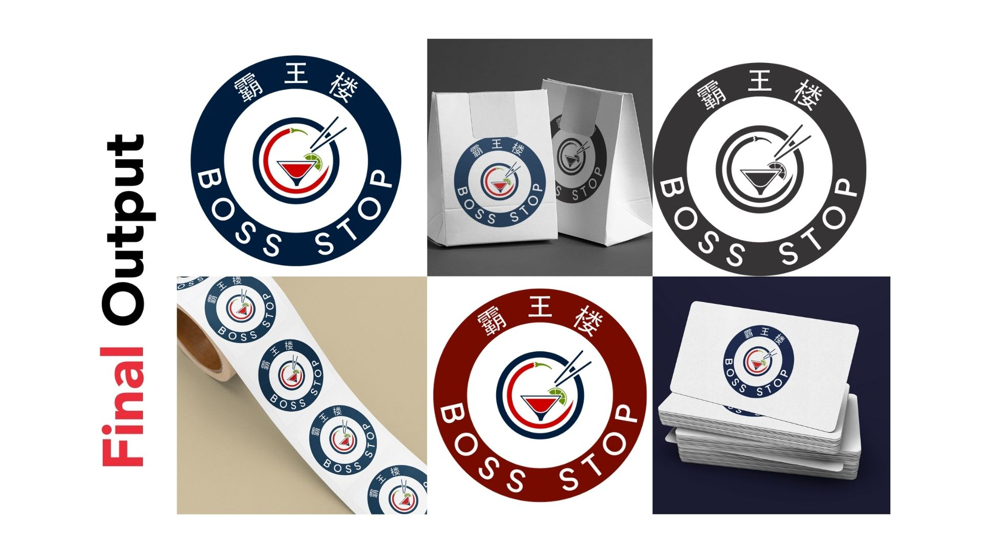
How Boss Stop Became a Standout Asian Fusion Brand in Dublin
Statement of the problem………………………
About the Client
Despite its innovative menu and excellent service, Boss Stop struggled to communicate its unique brand identity in a crowded market. Their branding lacked cohesiveness, and their online presence did not fully represent their quality and vision. With no clear brand strategy or alignment, they faced challenges in attracting new customers, enhancing visibility, and creating a memorable dining experience beyond their physical location.
Boss Stop needed more than just a facelift—they required a comprehensive branding overhaul to establish a strong, unified identity and solidify their place as a go-to destination for Asian
fusion cuisine.
Located in the heart of Dublin on vibrant George’s Street, Boss Stop is a contemporary Asian fusion restaurant dedicated to delivering innovative, high-quality cuisine. With a culinary team boasting over 35 years of experience, Boss Stop prides itself on using locally sourced ingredients to craft dishes that cater to diverse dietary needs, including premium meat cuts, halal chicken, and vegetarian options. Known for its warm, inviting atmosphere and exceptional customer service, Boss Stop sought to position itself as a standout in the bustling food and beverage industry.

Slide 38
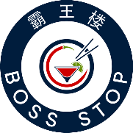
Our Approach & Solution
At BrandYou Creative, we understood that Boss Stop’s challenge wasn’t just about aesthetics; it was about defining who they were and ensuring every touchpoint communicated that message effectively. We adopted a collaborative, phased approach to address their needs holistically.
Discovery and Consultation
Conducted. in-depth brand audits and analysis to identify gapsm in their current strategy
Engaged with the client to understand their business operations, strategic goals, and target audience.
Brand Strategy Development
Created a comprehensive brand strategy that aligned their visual identity, culture, and customer expectations.
Developed a brand culture alignment plan, ensuring every element of their operations resonated with their core values.
Marketing and Awareness Campaigns
Launched brand awareness campaigns to position Boss Stop as a top dining destination.
Strategized and executed targeted digital marketing efforts to engage and grow their customer base.
Visual Identity and Materials
Redesigned their logo and visual elements, creating a fresh and memorable identity.
Delivered all logo formats, stickers, and brand materials for consistency across digital and physical platforms.
Conceptualized and executed shop designs, menus, uniforms, and onsite signage to enhance their physical presence.
Website Optimization and Design
Designed a user-friendly, visually appealing website tailored to their audience’s needs.
Selected and optimized high-quality images to represent their menu and ambiance authentically.
Enhanced the site with SEO best practices to improve visibility and drive organic traffic.

Slide 39
Achievements and Results.
Our efforts led to transformative results for Boss Stop:
Elevated Brand Identity
Boss Stop now boasts a cohesive, professional brand identity that resonates across all platforms, from their storefront to their online presence.
Increased Visibility
With SEO-optimized content and targeted marketing campaigns, website traffic increased, and local search rankings improved significantly.
Enhanced Customer Experience
The redesigned website and clear branding made it easier for customers to explore their offerings and connect with the restaurant.
Boost in Revenue
Greater brand awareness and increased foot traffic translated to a noticeable uptick in reservations and repeat customers.
UI/UX Website Design
Well designed and optimized website and pages suitable for both mobile and desktop users, which made it relatively easy for customers to access their website, make bookings and reservations, inquires, etc

Slide 40
Our Commitment
At BrandYou Creative Agency, we are passionate about empowering businesses like Boss Stop to achieve their full potential. Our expertise as a leading brand design agency Ireland and trusted branding consultants ensures that we deliver tailored solutions that address your unique challenges.
Our proven approach—grounded in strategic thinking, creativity, and attention to detail—ensures that we not only meet but exceed expectations. By partnering with us, you can expect a tailored strategy designed to elevate your brand, connect with your audience, and achieve your goals.
Ready to transform your brand like Boss Stop? Partner with BrandYou Creative Agency, where strategy and creativity meet to deliver extraordinary results. Reach out today, and let’s make your success story the next chapter in our portfolio!

Slide 41


Slide 42
Thomond Tyres

Slide 43
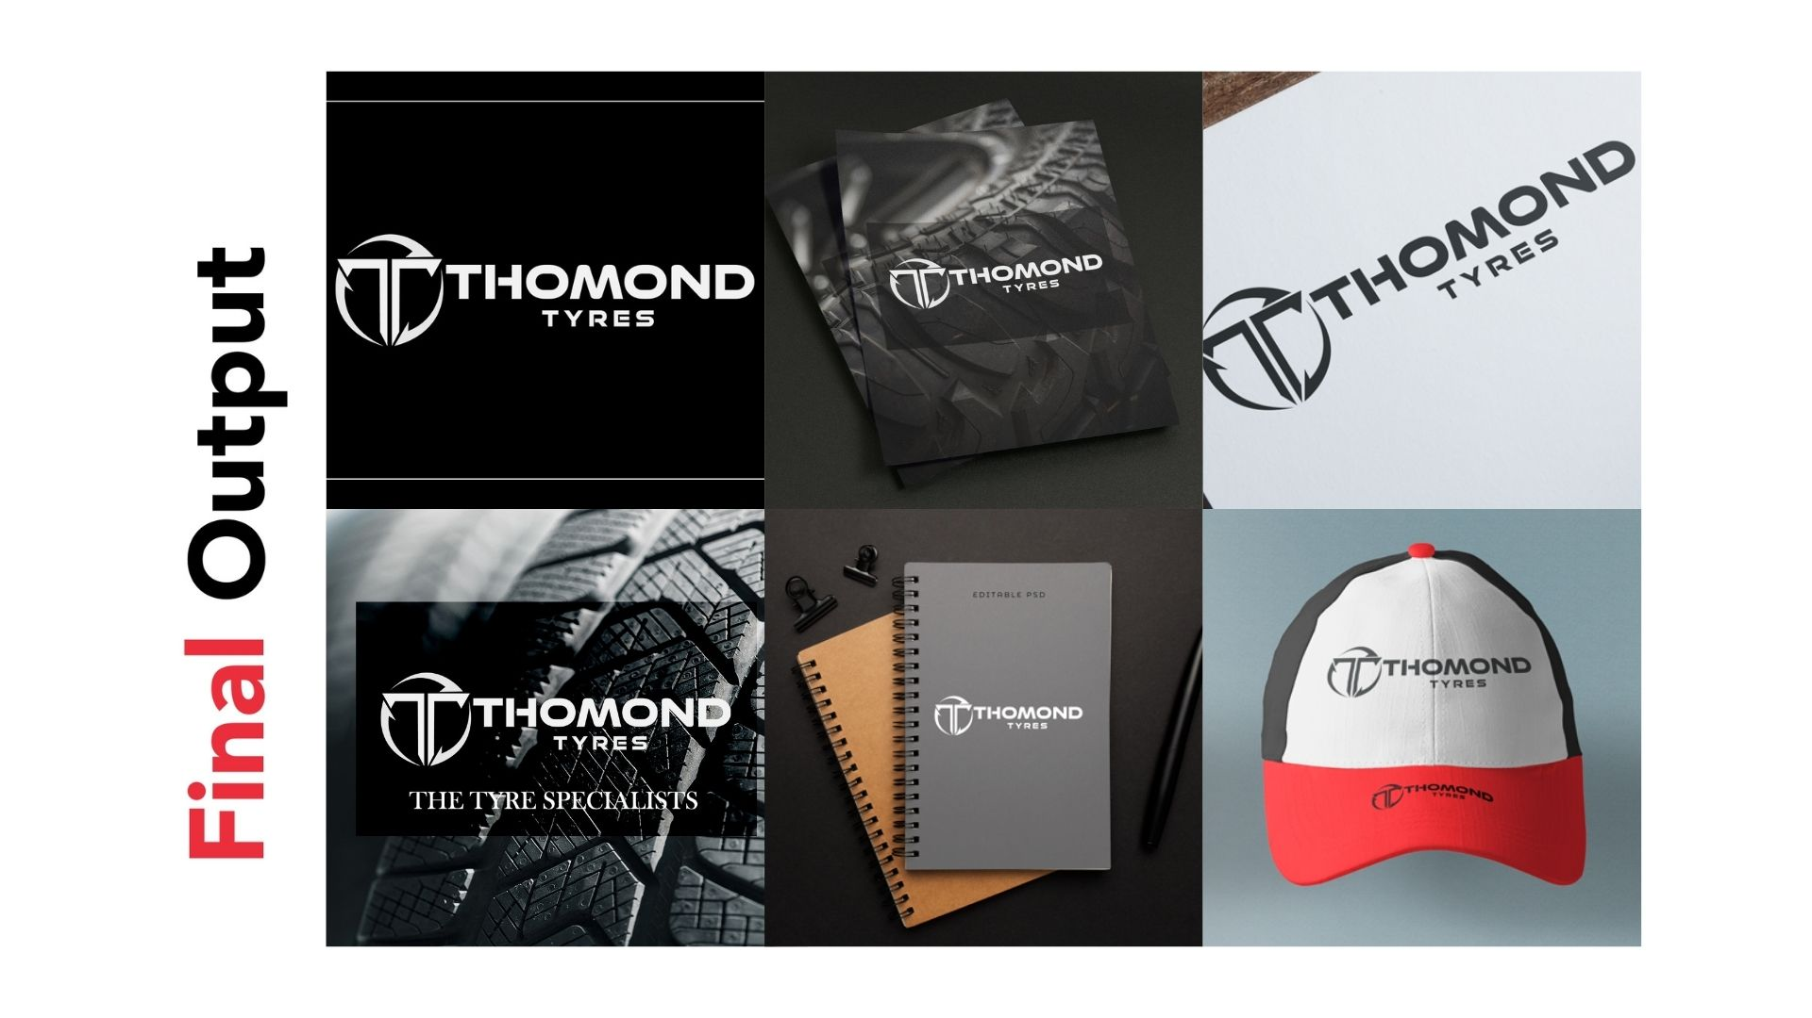
Revving Up Thomond Tyres' Digital Presence
About the Client
Statement of the problem………………………
Thomond Tyres had established itself as a trusted name in its local market but faced challenges when it came to expanding its brand visibility and digital footprint.
Limited Online Presence: Their outdated website failed to showcase their expertise, services, and innovation effectively. It was also not optimized for search engines, limiting organic traffic and audience engagement.
Inconsistent Branding: Visual materials lacked cohesiveness, resulting in a diluted brand identity.
Low Engagement: With no targeted content plan or optimized digital marketing strategy, they struggled to engage their audience and attract new customers.
Ineffective Marketing Strategy: With no clear plan for digital marketing or social media, Thomond Tyres struggled to stand out in the competitive tyre industry.
These issues not only hampered Thomond Tyres’ ability to compete in the tyre industry but also limited its potential to become a market leader.
Thomond Tyres is a premier tyre provider renowned for its commitment to vehicle safety and performance. Based in Ireland, the company offers cutting-edge tyre technology, expert services, and comprehensive solutions through its Tyre Tech Auto center. Whether it’s professional tyre fitting, expert advice, or reliable maintenance services, Thomond Tyres empowers drivers to hit the road with confidence. With innovation at its core, the company prides itself on providing advanced tyre solutions that meet the highest industry standards.

Slide 44

Our Approach & Solution
Digital Marketing Strategy
Designed and implemented a targeted marketing plan, including PPC campaigns and Facebook marketing strategies.
Claimed and optimized their Google My Business profile to improve local search visibility.
Integrated tools like Google Analytics and Search Console to track website performance and audience behavior.
Ongoing Support
Provided a content plan to maintain consistency in messaging and audience engagement.
Delivered detailed guidance on brand alignment and strategic planning to ensure long-term success.
At BrandYou Creative, we recognized that a holistic approach was essential to revitalize Thomond Tyres’ brand and online presence. Our tailored strategy included the following steps:
Comprehensive Consultation
We conducted in-depth discussions to understand their business operations, strategic goals, and target market.
Analyzed their existing brand assets and digital presence to identify key areas of improvement.
Brand Development and Visual Identity
Created a cohesive visual identity, including logo variations, signage, and branded materials like business cards.
Aligned the brand’s look and feel to reflect their core values of innovation, safety, and reliability.
Website Redesign and Optimization
Developed a modern, user-friendly website with optimized UI/UX design for both mobile and desktop users to enhance customer experience.
Delivered SEO-rich content tailored to their target audience, ensuring better online visibility.
Sourced, curated, and optimized impactful images for the website to highlight their products and services.

Slide 45
Achievements and Results.
Stronger Brand Identity: Thomond Tyres now boasts a professional, cohesive brand that reflects their expertise and innovation.
Enhanced Online Visibility: The new website saw an amazing increase in organic traffic within the first four months, ranking higher for targeted keywords.
Improved Customer Engagement: PPC campaigns and an optimized Google My Business profile led to increased inquiries and footfall at their Auto center.
Increased Revenue: With improved brand visibility and audience engagement, Thomond Tyres experienced a noticeable uptick in sales and customer loyalty.

Slide 46
Our Commitment
At BrandYou Creative, we're more than just a creative agency; we're your strategic partner in growth. Our team of seasoned experts is dedicated to transforming your brand into a powerful force.
Just as we successfully elevated Thomond Tyres' brand identity and digital presence, we're poised to deliver exceptional results for your business. Whether you're seeking to revitalize your website, craft a compelling brand story, or optimize your marketing strategies, we're committed to exceeding your expectations.
Let us help you become the hero of your own success story. Partner with BrandYou Creative today and experience the power of innovative branding and digital marketing.
This remarkable transformation is a testament to our dedication and expertise. Partnering with us opens doors to similar transformative journeys for brands seeking to thrive in today’s dynamic market landscape.

Slide 48
RackMove

Slide 49
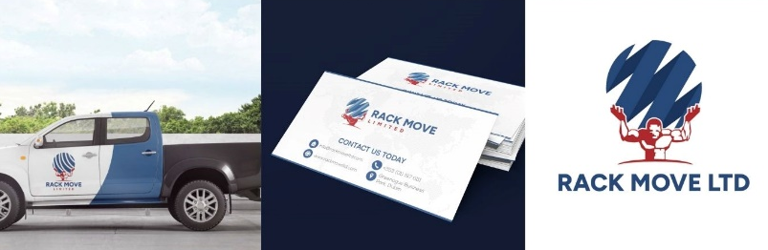
Transforming RackMove’s Digital Presence Through Strategic Branding and Design
About the Client
Statement of the problem………………………
RackMove is a leading name in the manufacturing industry, providing ergonomic material handling solutions that prioritize safety, efficiency, and workplace ergonomics. Specializing in server rack lifting and moving equipment, their products are rigorously tested for optimal performance, ensuring clients experience unmatched reliability and innovation. By delivering tailored solutions, RackMove helps businesses streamline operations, minimize workplace injuries, and enhance overall productivity.
While RackMove’s engineering expertise was widely recognized, they faced challenges in establishing a compelling online presence and cohesive branding to reflect their market leadership. That’s where BrandYou Creative stepped in.
Despite its superior products and stellar reputation, RackMove struggled to convey its brand identity effectively. Their website was outdated, lacked engagement, and did not align with their innovative ethos. Their visual identity was inconsistent, leading to missed opportunities for connecting with potential clients and standing out in the competitive construction industry.
RackMove's leadership sought a digital and branding transformation that would:
Establish a professional, cohesive, and modern visual identity.
Enhance their online visibility to attract a broader audience.
Develop a website that was not only visually appealing but functional, user-friendly, and aligned with their business goals.
RackMove needed a trusted partner to bring this vision to life.

Slide 50
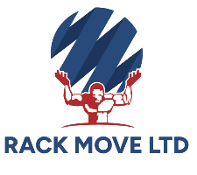
Our Approach & Solution
At BrandYou Creative, we recognized that RackMove’s branding and digital identity needed a comprehensive overhaul to match their innovative product offerings. Our strategy combined deep collaboration and expert execution:
Discovery Phase:
We engaged with RackMove’s leadership team to understand their operations, target market, and growth ambitions. This process laid the foundation for a strategy that reflected their core values and business objectives.
Re-Branding Visual Identity:
Developed a refreshed logo that exuded modernity and professionalism.
Designed a cohesive visual identity, including brand guidelines, ensuring consistency across all platforms and materials.
Delivered branded materials such as onsite signage, vehicle decals, and product branding.
Website Design & Development:
Created a visually compelling and intuitive website optimized for SEO and usability with great UI/UX optimized for both mobile and desktop users.
Integrated key features, including Google Search Console, Analytics, and a CMS manual, empowering RackMove to self-manage content updates.
Guided image selection and optimization to enhance user engagement and professionalism.
Marketing Strategy:
Crafted a tailored strategy to boost audience engagement and align messaging across digital channels.
Delivered tools and training to ensure RackMove could maintain the momentum post-launch.

Slide 51
Achievements and Results.
Our partnership resulted in a complete transformation of RackMove’s digital and branding presence. Key achievements included:
Increased Online Visibility:
RackMove’s new website saw a significant uptick in organic traffic within three months, attracting a broader and more relevant audience.
Stronger Brand Identity:
The cohesive visual identity positioned RackMove as a trusted and innovative leader, elevating their credibility among potential clients and partners.
Enhanced Engagement:
The intuitive website design led to an increase in inquiries and a significant improvement in user experience metrics, such as average session duration and bounce rate.
Empowered Team:
With CMS training and detailed brand guidelines, RackMove’s team was equipped to maintain a consistent and effective brand presence independently.

Slide 52
Our Commitment
At BrandYou Creative, we believe in crafting success stories like RackMove’s by combining strategic insights with creative brilliance. Our commitment to understanding your business ensures tailored solutions that deliver measurable results. With a track record of transforming brands across various industries, we are uniquely positioned to:
Build a cohesive and compelling visual identity that resonates with your target audience.
Enhance your online presence with websites designed for both function and aesthetics.
Equip your team with the tools and knowledge to sustain success.
When you choose BrandYou Creative, you’re not just hiring a marketing agency; you’re gaining a partner dedicated to helping you achieve your goals and becoming the hero of your own success story.
This remarkable transformation is a testament to our dedication and expertise. Partnering with us opens doors to similar transformative journeys for brands seeking to thrive in today’s dynamic market landscape.

Slide 53


Slide 54
IrelandKIND

Slide 55
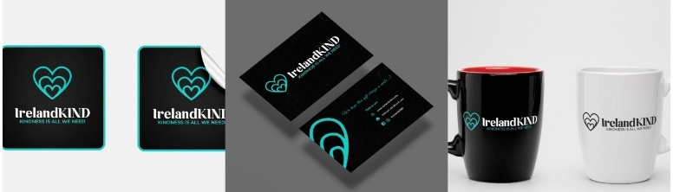
IrelandKIND: A Story of
Transformation Through
Thoughtful Branding
Statement of the problem………………………
When IrelandKIND approached BrandYou Creative, they faced several challenges:
Outdated Visual Identity:
Their branding failed to reflect the warmth, professionalism, and inspiration at the heart of their mission.
Disconnected Messaging:
Inconsistent and unclear messaging made it difficult for them to resonate with their audience.
Minimal Digital Presence:
With limited online visibility, IrelandKIND was struggling to reach and engage their target audience.
Lack of SEO and Social Media Strategy:
Their digital content was not optimized to attract the attention it deserved, and social media efforts lacked clear direction.
IrelandKIND needed a transformation—a cohesive branding and digital strategy to position them as a leading advocate for kindness and compassion.
About the Client
IrelandKIND is a purpose-driven social enterprise committed to spreading compassion and empathy. Through their Kindness Academy, they deliver innovative training programs, workshops, and coaching to empower individuals, organizations, and communities to adopt kindness as a cornerstone of their values.
Their mission is ambitious: to inspire positive change and foster a more compassionate society. However, despite the powerful impact of their programs, IrelandKIND struggled to effectively communicate their message and connect with their audience in a meaningful way.

Slide 56

Our Approach & Solution
Marketing Plan and Social Media Strategy
We developed a targeted marketing strategy, with a focus on Facebook advertising, to connect with their audience and increase engagement.
We set up and optimized their Google My Business profile to enhance local visibility and credibility.
A comprehensive content plan was created, including blog topics, social media posts, and email campaigns, to maintain audience interest and drive conversions.
Analytics and Monitoring
Google Analytics and Google Search Console were integrated to monitor website traffic and performance.
Detailed reports and insights were shared with IrelandKIND to guide ongoing improvements.
Training and Empowerment
We provided a CMS manual and training to enable the IrelandKIND team to confidently update their website.
Social media strategy training ensured their internal team could execute campaigns effectively.
We collaborated closely with the client to gain a deep understanding of their business operations, strategic goals, target market, and unique value proposition. Armed with this knowledge, we developed a comprehensive plan that included website design and development, marketing strategy, rebranding, and brand guideline development. We then finalized the design, marketing plan, strategy, and execution.
Rebranding Visual Identity
We developed a modern, cohesive logo and brand identity system that embodied IrelandKIND’s core values of warmth, empathy, and inspiration.
A detailed brand guideline was created to ensure consistency across all platforms, including colors, typography, and tone of voice.
Website Development
We designed and built a user-friendly, visually appealing website to showcase their programs and mission effectively.
Basic SEO practices were implemented to optimize the site for search engines, improving discoverability.

Slide 57
Achievements and Results.
The results of our partnership with IrelandKIND were profound:
Stronger Online Presence:
The revamped website saw a drastic increase in organic traffic within three months of launch.
Improved Engagement: Social media followers grew, with increasing post engagement thanks to our consistent, targeted messaging.
Enhanced Discoverability:
IrelandKIND began ranking on google search results for several relevant keywords, driving more inquiries.
Unified Brand Identity:
Feedback from stakeholders highlighted the professionalism and emotional resonance of their new branding.
Empowered Team:
IrelandKIND’s team felt confident managing their digital platforms, ensuring sustained growth.
This transformation enabled IrelandKIND to reach new audiences, strengthen their community, and effectively communicate their message of kindness.

Slide 58
Our Commitment
At BrandYou Creative, we specialize in helping organizations like IrelandKIND amplify their message and achieve their goals. Here’s why you can trust us to deliver similar results:
Tailored Solutions: Every business has unique needs, and we customize our services to meet those challenges.
Proven Expertise: With our expertise in branding, digital strategy, and marketing, we consistently deliver impactful results.
End-to-End Support: From planning to execution, we’re with you every step of the way to ensure your success.
Just like IrelandKIND, you too can unlock your potential and create meaningful connections with your audience.
Are you ready to elevate your brand, expand your reach, and achieve your goals? At BrandYou Creative, we help turn visions into success stories. Let us craft your journey to becoming the standout in your field.
Contact us today to start your transformation. Together, we’ll create a brand that inspires, connects and build lasting relationships!
.
This remarkable transformation is a testament to our dedication and expertise. Partnering with us opens doors to similar transformative journeys for brands seeking to thrive in today’s dynamic market landscape.

Slide 59


Slide 60
Kilbride Coaches

Slide 61
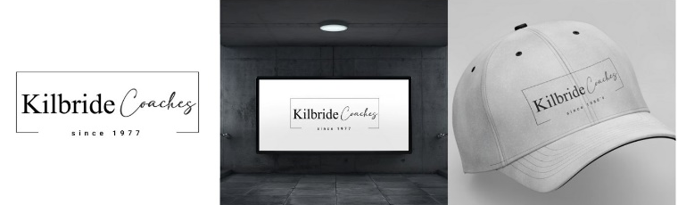
Kilbride Coaches: A Journey to
Digital Transformation and Brand Excellence
Statement of the problem………………………
Kilbride Coaches approached BrandYou Creative with several pressing issues hindering their growth:
Outdated Digital Presence: Their limited online presence, characterized by an outdated website that failed to effectively showcase their expertise, services, and innovation, hindered their ability to attract organic traffic and engage their target audience. The website's lack of search engine optimization further limited its visibility and impact.
Inconsistent Branding: Their brand identity didn’t align with their reputation for professionalism and reliability.
Limited Online Visibility: With minimal SEO efforts and no cohesive digital marketing strategy, they struggled to compete in the crowded transportation market.
Fragmented Communication: Their messaging lacked clarity and failed to convey their unique value proposition effectively.
Kilbride Coaches needed a transformative branding strategy to enhance their online presence, engage their audience, and solidify their position in the competitive transport industry.
About the Client
Kilbride Coaches is a trusted name in Ireland’s transportation industry, known for providing high-quality bus services that prioritize reliability, safety, and comfort. With a modern fleet of vehicles and a professional, experienced staff, they cater to diverse customer needs—from individual travelers to group tours. Their commitment to punctuality and superior customer experience has established them as a leader in the field.
Despite their stellar reputation offline, Kilbride Coaches faced challenges in translating their brand values into a compelling online presence.

Slide 62
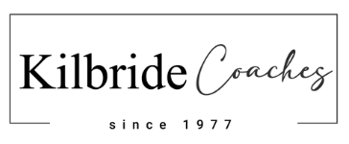
Our Approach & Solution
To help Kilbride Coaches overcome their challenges we conducted a thorough consultation with the client to gain a deep understanding of their business operations, strategic goals, target market, and unique value proposition. Leveraging this insight, we developed a comprehensive strategic plan encompassing website design and development, marketing strategy, rebranding, and brand guideline development. Subsequently, we finalized the design, marketing plan, strategy, and execution.
Discovery and Strategic Planning
We conducted in-depth consultations with Kilbride Coaches to understand their business goals, target audience, and competitive landscape.
A comprehensive strategic plan was developed, including rebranding, website design, SEO optimization, and content marketing.
Rebranding and Visual Identity
We created a refreshed logo that conveyed Kilbride’s professionalism, reliability, and modernity.
A cohesive visual identity system, including brand guidelines, ensured consistency across all touchpoints—from vehicle signage to marketing materials.
Website Design and Development
We designed a bespoke, user-friendly website that emphasized seamless navigation and visually engaging design.
The site was optimized for both desktop and mobile users, featuring clear calls-to-action and comprehensive service information.
Content text was rewritten to highlight Kilbride’s unique offerings, customer benefits, and commitment to excellence.
Digital Marketing and SEO
We implemented a targeted SEO strategy to improve Kilbride’s search engine rankings and drive organic traffic.
Google Analytics and Search Console were integrated to monitor website performance and inform future decisions.
A PPC and Facebook marketing strategy was developed to expand their reach and engage with potential customers.
Content and Branding Materials
A content plan was delivered to guide ongoing blog posts, social media updates, and email campaigns.
We designed and provided all logo formats, stickers, onsite signage, and vehicle branding to ensure a professional, cohesive appearance.

Slide 63
Achievements and Results.
Our partnership with Kilbride Coaches delivered impressive results:
Enhanced Online Presence: The new website saw an exponential increase in traffic within the first three months, with a significant boost in mobile visitors.
Improved Brand Recognition: The refreshed logo and visual identity resonated with customers, solidifying Kilbride’s reputation as a modern, reliable transportation provider.
Higher Engagement: Social media campaigns increased follower count, while PPC ads led to a significant rise in inquiries.
Boosted SEO Rankings
Streamlined Communication: The cohesive branding and clear messaging created a unified experience across all platforms, strengthening customer trust and loyalty.
Kilbride Coaches successfully transitioned into a digitally savvy, customer-focused brand that stands out in the competitive transportation industry.

Slide 64
Our Commitment
At BrandYou Creative, we understand the challenges businesses face in building a strong, consistent brand. Whether you’re in transportation or any other industry, we’re committed to helping you achieve your goals through strategic planning, creative design, and effective marketing execution.
Here’s why you can trust us to deliver results:
Customized Strategies: Every business is unique, and we tailor our services to meet your specific needs.
Proven Expertise: With a track record of success, we combine creativity with data-driven strategies to maximize impact.
Comprehensive Support: From discovery to implementation, we’re with you every step of the way.
Just like Kilbride Coaches, you can elevate your brand, engage your audience, and achieve your business objectives with BrandYou Creative.
Let’s create your success story. Contact us today to start your journey toward a powerful, results-driven brand transformation!
This remarkable transformation is a testament to our dedication and expertise. Partnering with us opens doors to similar transformative journeys for brands seeking to thrive in today’s dynamic market landscape.

Slide 65


Slide 66
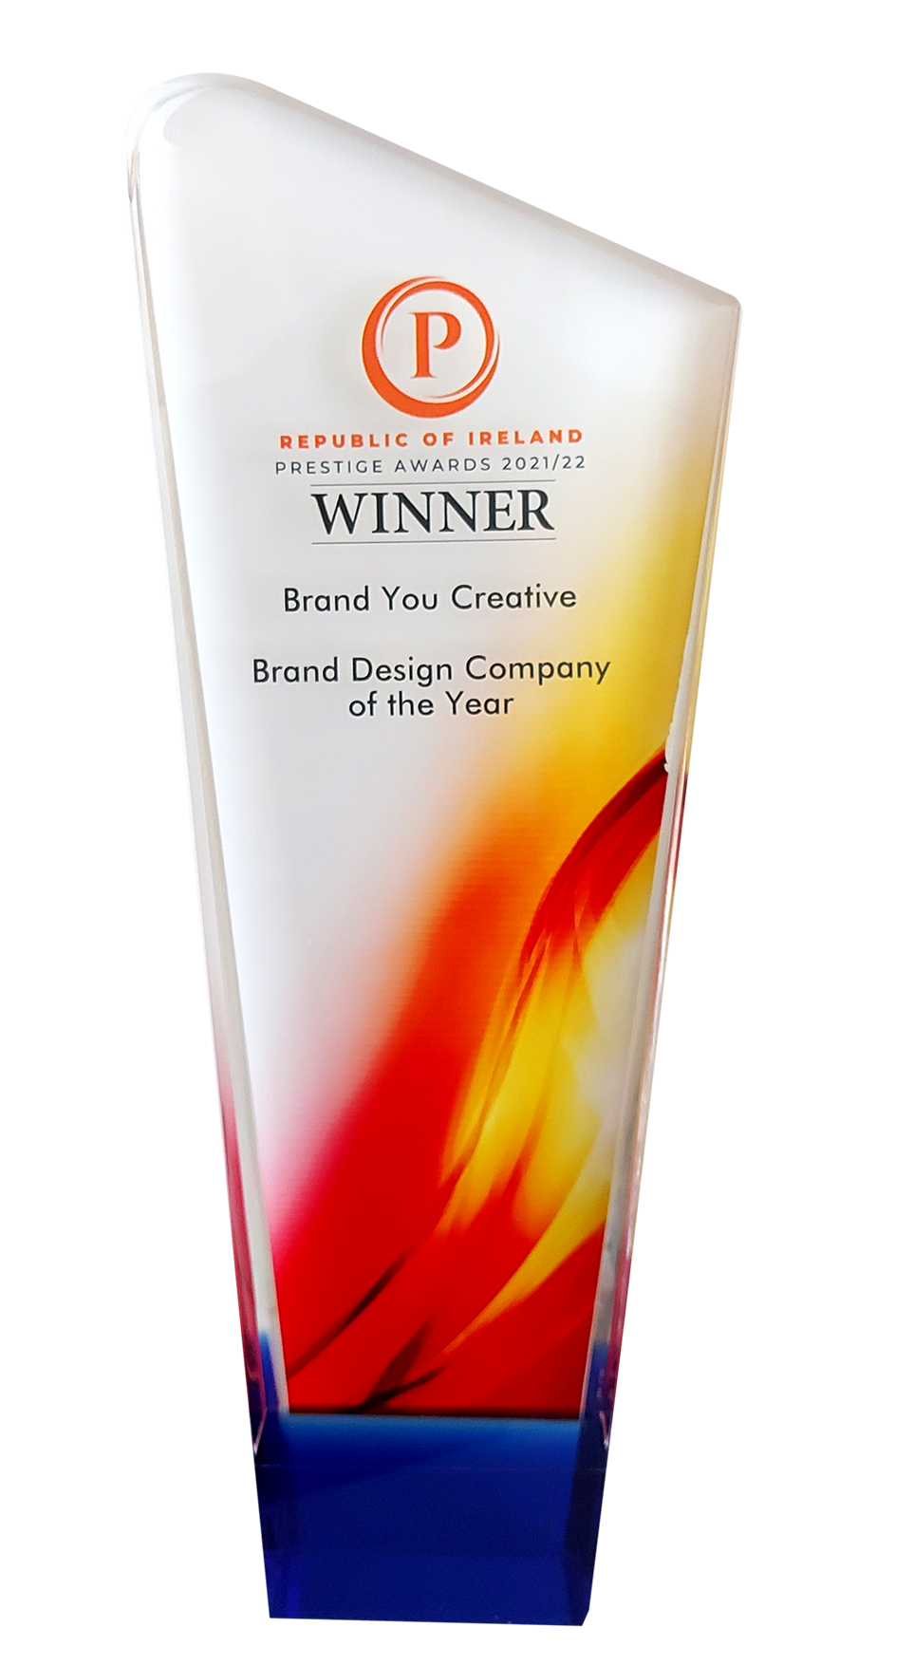
Multi – Award winning Branding & Marketing Agency
Over a Consecutive Number of Years

Slide 67









Contact Information
ADDRESS
Keepers Cottage , 3 Dublin Road
Leixlip Co. Kildare
W23H3C4 Ireland
EMAIL ADDRESS
lee@brandyou.ie
www.brandyou.ie
PHONE NUMBER
Dublin +353 1 270 9501
Dublin +353 1 270 8997
Mobile +353 85 251 2558

Slide 68


